Slide 1
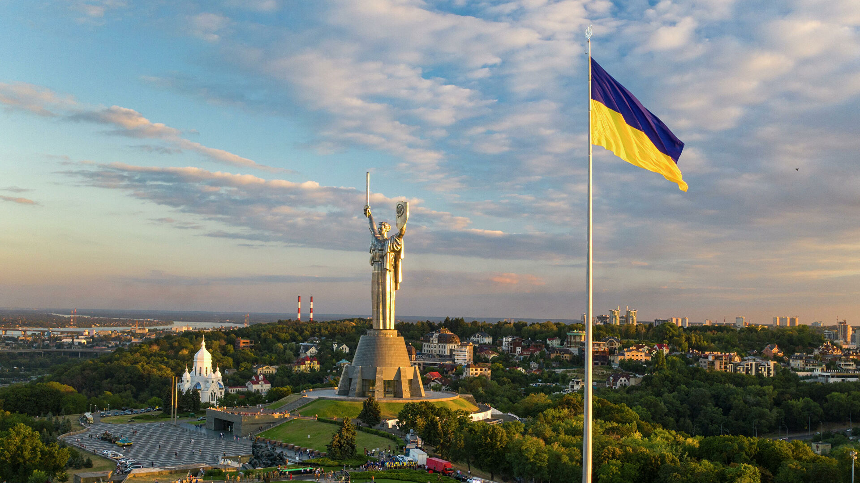
State symbols of Ukraine
The presentation was prepared by:
Saveliev A. A., Dean of the Educational Institute of Foreign Citizens Training
Kunitsyn M. V., Deputy Dean of the Educational Institute of Foreign Citizens Training

Slide 2
State symbols of Ukraine

Slide 3

State symbols of Ukraine
Each country has state symbols. Ukraine also has its state symbols. The state symbols of Ukraine are the coat of arms, flag, and anthem.
A hymn (from the Greek hymns) is a solemn song that glorifies the state.
The coat of arms (emblem) is the official emblem of the state.
Flag - a panel of the correct shape of a particular color (or colors) and symbolism.
The state symbols of Ukraine are enshrined in the Constitution of Ukraine. Article 20." the state symbols of Ukraine are the national flag of Ukraine, the State coat of arms of Ukraine and the National Anthem of Ukraine."

Slide 4

The coat of arms (emblem) of Ukraine
The coat of arms (emblem) of Ukraine is a golden trident on a blue background. Scientific historians believe that the Trident symbolizes the trinity of the world – the unity of earth, water, and air.

Slide 5

The national flag of Ukraine
The national flag of Ukraine consists of blue and yellow stripes. Blue represents a peaceful blue sky, and yellow represents a wheat field as a symbol of life. Thus, the flag of Ukraine is a symbol of peace, life, work, Beauty, and wealth of the native land.

Slide 6

National anthem of Ukraine
National anthem of Ukraine – "Ukraine's glory and will Are Not Dead Yet." The words of this majestic song were prevalent, as they called on Ukrainians to fight for their independence.
The authors of the national anthem of Ukraine are the Ukrainian poet Pavel Chubinsky, who wrote the words in 1862. The music for the poems was written by the composer Mikhail Verbitsky in 1865.

Slide 7
State symbols of cities of Ukraine

Slide 8

Not only states but also cities have their symbols. For example, the city of Odessa also has its symbols. It is the coat of arms, flag, and anthem.

Slide 9
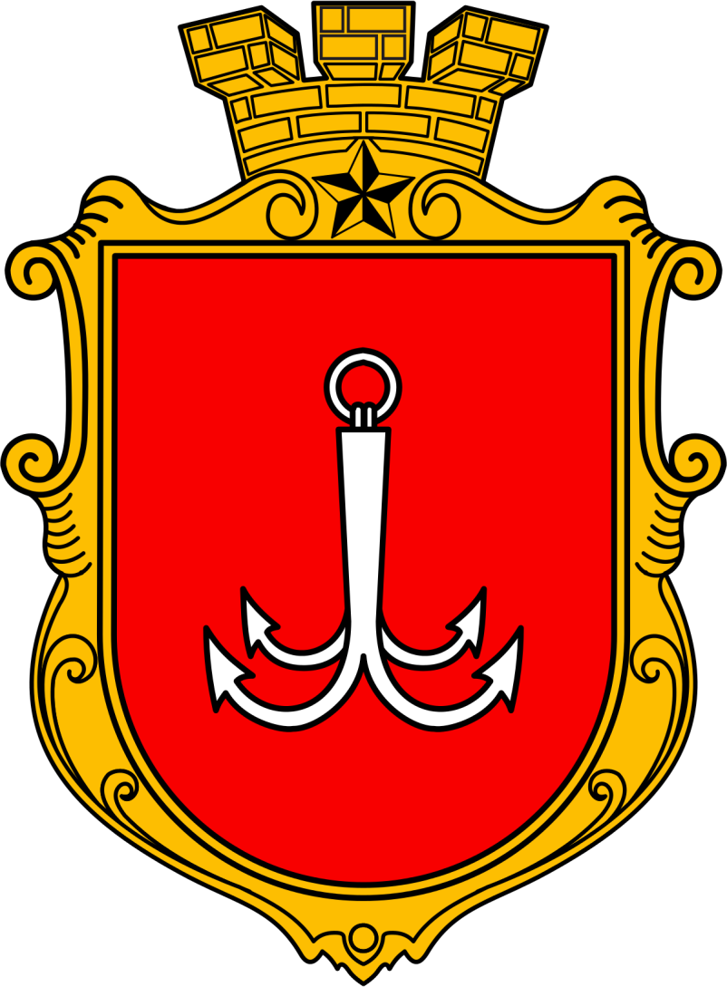
Coat Of Arms Of Odessa
Coat of arms of Odessa – Red Shield. On the shield is a silver anchor. Top with the Golden City Crown. Under the crown is a Gold Star. What does the coat of arms of Odessa mean? The red shield symbolizes the struggle for access to the sea. Red is a symbol of courage. The silver anchor is the emblem of the port city. The Golden Star is a symbol of the Hero City, which Odessa received for the heroic defense of the town during the Great Patriotic War (1941-1945). Finally, the golden crown is a symbol of wealth and prosperity.

Slide 10
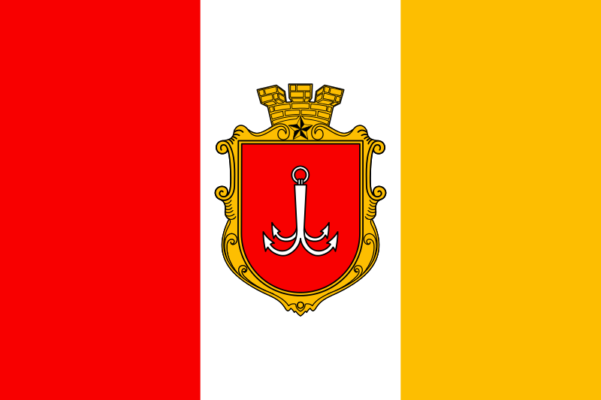
Flag Of Odessa
The flag of Odessa consists of stripes of red, white, and yellow colors. Red color – courage and heroism of Odessa residents, white – purity of their soul, yellow – wealth and prosperity of Odessa. So, Odessa is a European city with the spirit of freedom, equality, and brotherhood.

Slide 11


National anthem
Odessa also has its national anthem. The song "by the Black Sea" was written in 1951 by poet Semyon Kirsanov and composer Modest Tabachnikov. The first performer of this song-anthem was Leonid Utesov.
Odesa national anthem-song" by the Black Sea“
https://www.youtube.com/watch?v=iIzjCEB0Nu8
Leonid Utesov (1895-1982).
Monument to L. Utesov in the city garden, Odesa

Slide 12
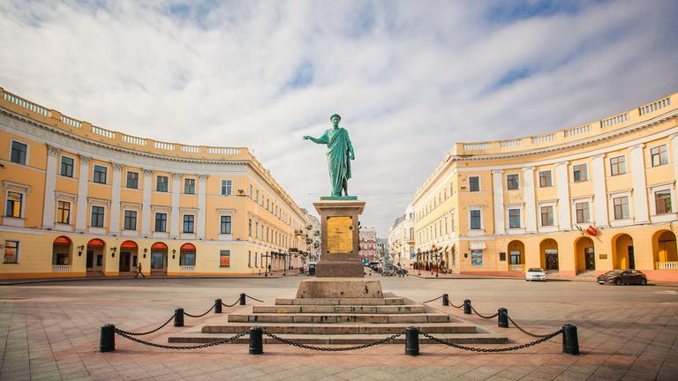
Odesa is a city on the Black Sea coast

Slide 13





THANKS
Does anyone have any questions?
Follow Us on Social Media
dec.ipig@opu.ua
opu.ua
fspirki.opu.ua
facebook.com/IPIG.ONPU
Project manager: lebedmy@gmail.com
The presentation was prepared by:
Saveliev A. A., Dean of the Educational Institute of Foreign Citizens Training
Kunitsyn M. V., Deputy Dean of the Educational Institute of Foreign Citizens Training

